Slide 1
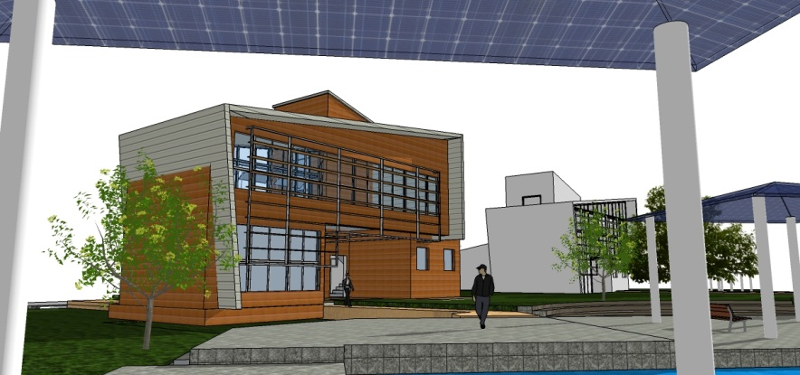
Architectural Passive Design Strategies
Ass. Lec. Binaee Yaseen Raof
Faculty of Engineering , Department of Architectural
BSc. Architecture Engineering
MSc. Renewable Energy and Architecture
1

Slide 2
Objectives:
The purpose of using passive design systems
Explaining the types of passive system.
Designing some types of the system with showing their environmental effect
Conclusion and design recommendation for reducing active load.
Introduction: The main purpose of architectural passive design is minimizing the energy demands for active heating and cooling system. In passive design provides visual and thermal comfort within the buildings by creating appropriate systems to control heat gains and losses during the whole year.
Main types of heat gain (conduction, convection and radiation )
2

Slide 3
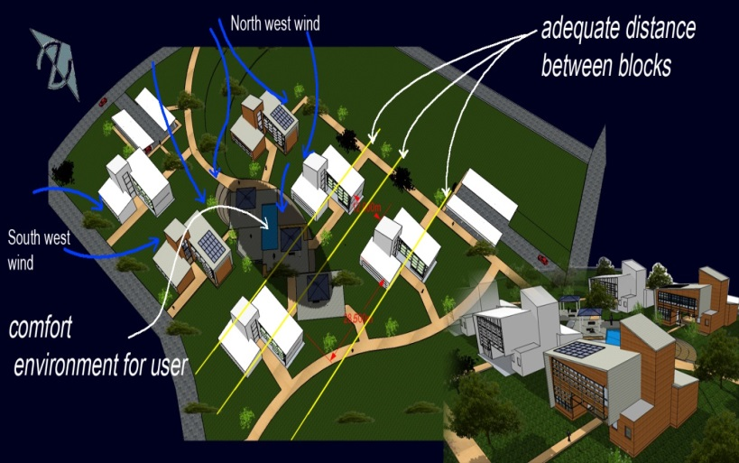
Orientation and block position: The most important point that needs to be consider in hot dry climate region is ventilation and reducing heat gain .
Therefore, building orientation depends on the wind directions also solar heat must be considered. The more suitable orientation that is defined is “orientating the longest façade between 30⁰ and 120⁰ to the prevailing wind direction short axis to east-west for protection from heat gain. (The dominant winds are from the north and northwest in Kurdistan) Wind speed in winter reaches 10 m/s

Slide 4
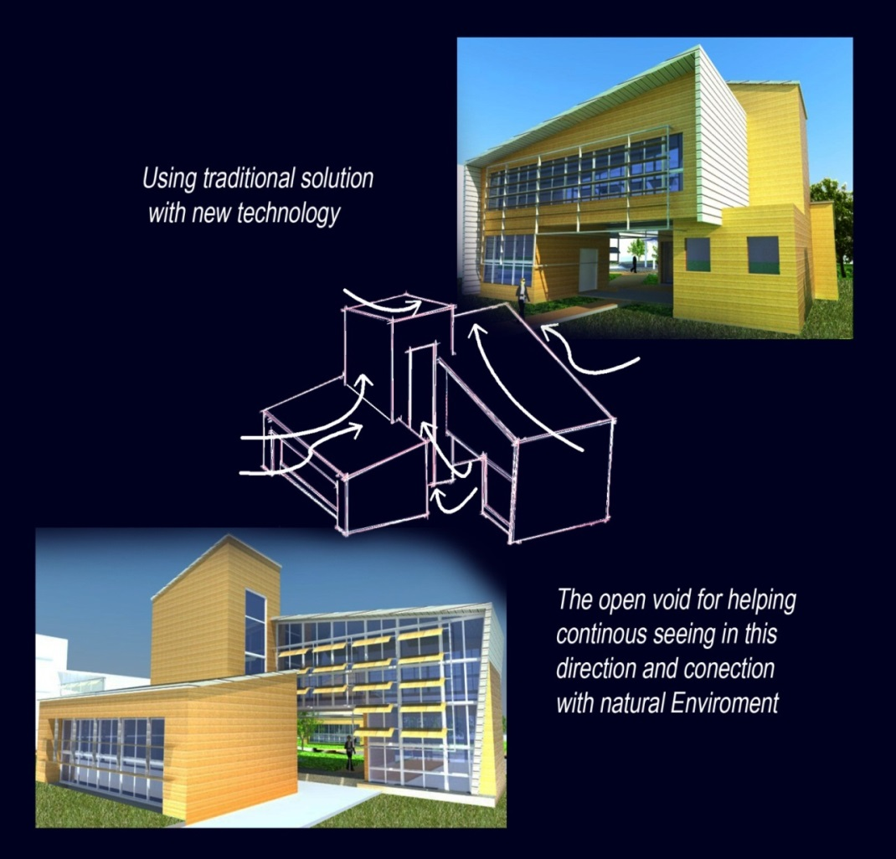
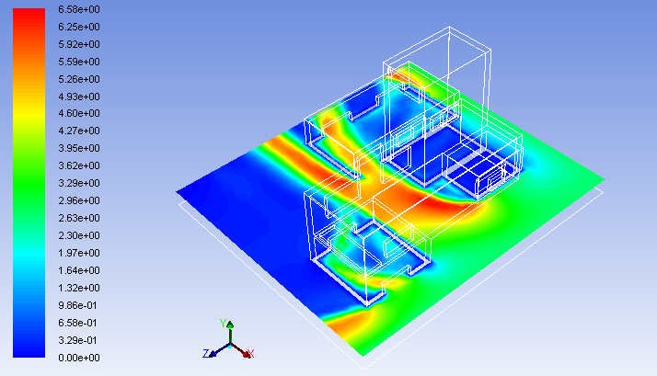
The effect of orientating long axis of the building to the prevailing wind.
4

Slide 5
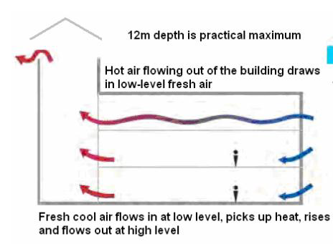
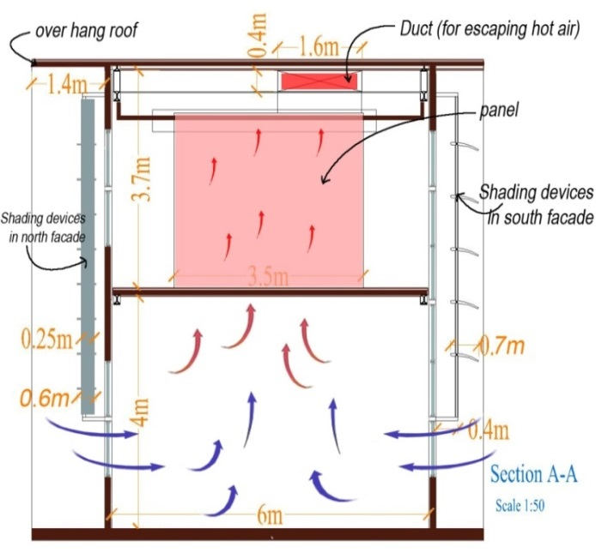
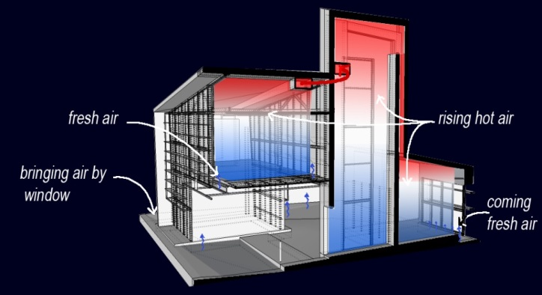
-Cooling strategy:
Stack effect : Happens as a result of having different air pressure, the difference between air temperature and air density is increasing stack effect , cooling air enters through the lower opening of the building and hot air go out by the upper opening.
Temperature differences results of the heating by the occupants, lighting and other internal heat source. The ventilation area may be maximized by increasing the vertical distance between the inlet and outlet.

Slide 6
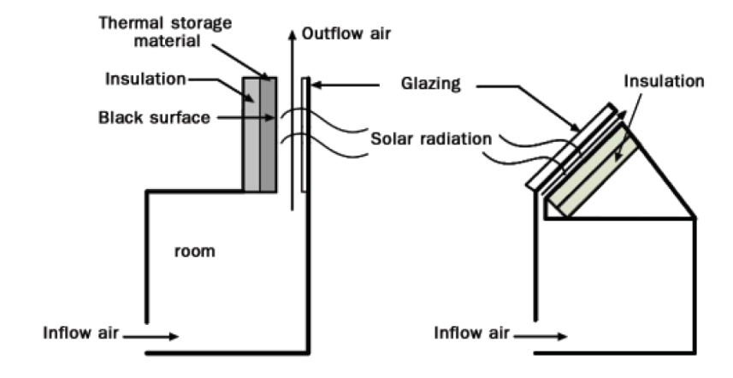
Solar chimney: it can use in a hot climate with having high solar radiation , consists of a glazed channel with a black painted chimney and is put at the top of the building.
When the chimney is heated by solar radiation it helps increasing natural stack effect which is driven by the difference between the inside and outdoor air temperature with having an opening space at the high and another low opening.

Slide 7
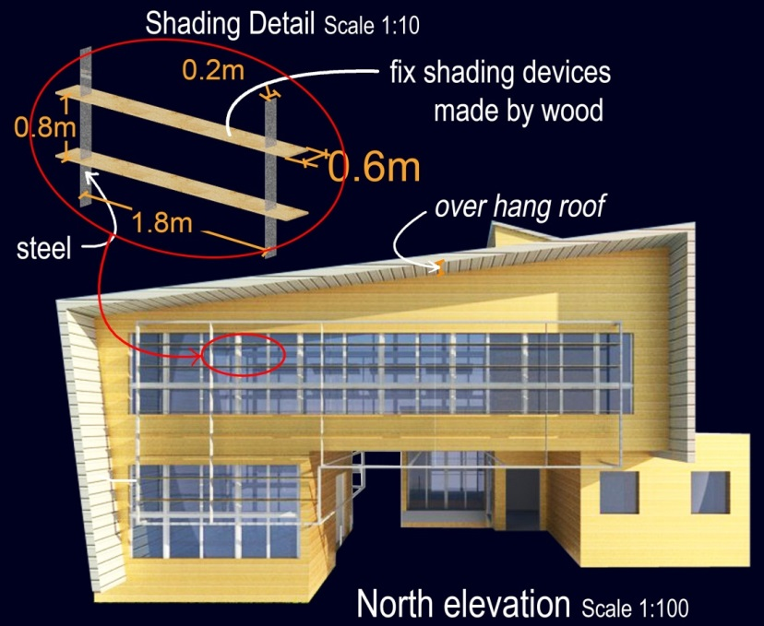
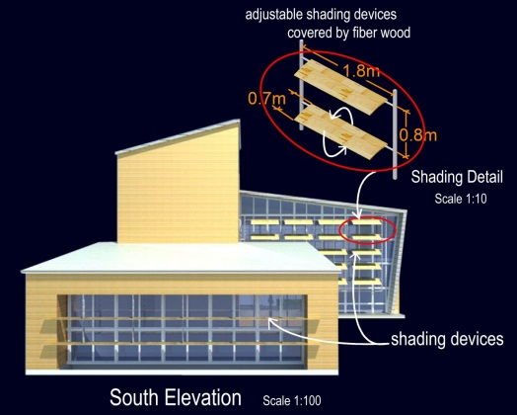
-Window and Shading devices
The main reason of heat gains in a building is solar gain through windows.
window should be placed according the wind direction with considering the sun heat that is not acceptable.
For the north and south facades fixed or adjustable horizontally shading devices have positive affect.
The east and west facades must have less area of glazing for preventing from solar radiation for reducing heat gain and decreasing cooling load .

Slide 8
-Wind catcher: The main elements in Natural ventilation system are wind tower and earth air tunnel. The design of the wind towers is very complicated. Three are many factors affect air flow such as, average velocity, prevailing wind and seasonal and daily variation of wind speeds
They designed to catch the wind from both north and north west sides. When the wind flow from the north, the north inlet enters the air to the tower and other should be closed by a technical detail.
The other effective element is small area of water in the end of the wind towers’ channels. The water is used only in hot seasons when the evaporative ventilation is needed.

Slide 9
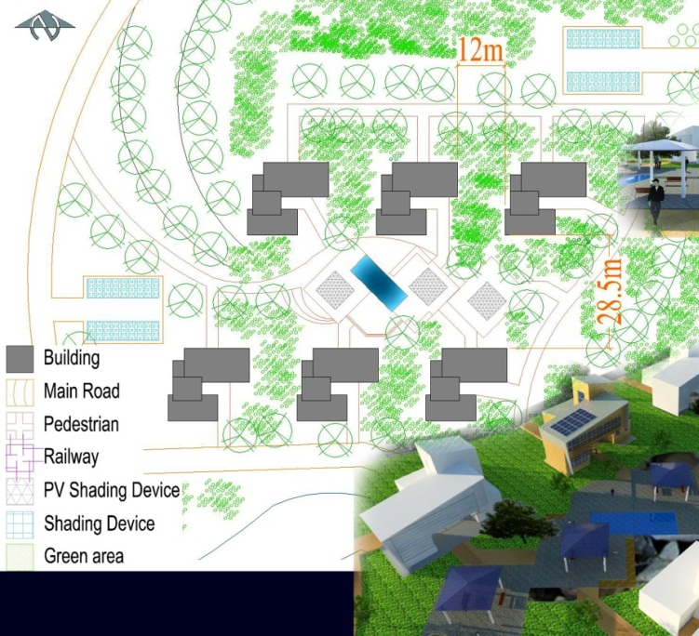
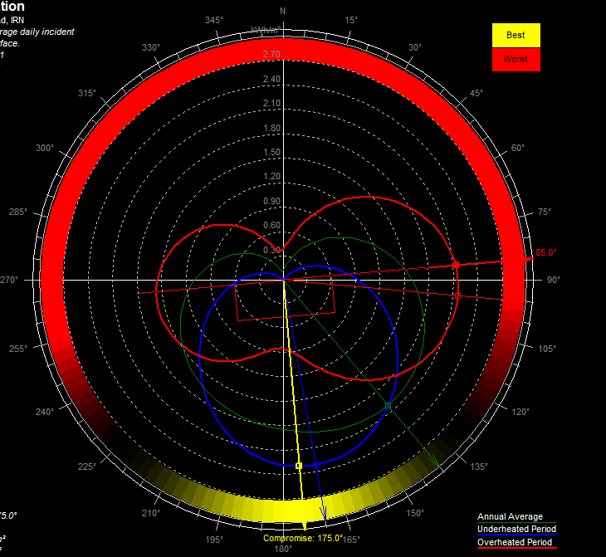
Conclusion
1-Position: | putting the highest blocks in the west and can protect the lower blocks from the sun’s radiation
2-Orientation: | south with 5° rotation to east depending on the solar radiation, and facing the wind tower to the north and north-west.
3-Reducing solar radiation | Reducing glazing area on the east and west facades using shading devices and overhang roof
4- Natural ventilation: | Stack effect wind towers, earth air tunnels and evaporative cooling. Designing green area can produce difference air velocity.

Slide 10
Thank you….
Any question????

