Slide 1
THE ABSENCE OF THE ARCHITECT
CIHAN UNIVERSITY 2018

Slide 2
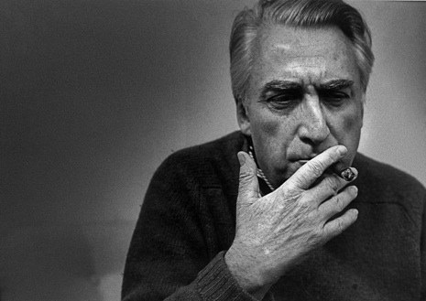
Roland Barthes
“The Death of the Author”
November 12, 1915 – March 26, 1980
Notes:
Since Roland Parthes published his essay entitled the death of the author at 1967 and there is an accelerated trend to see art work through structural point of view

Slide 3
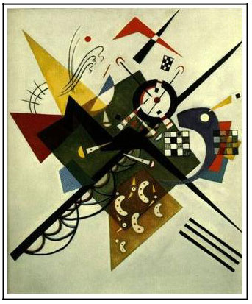
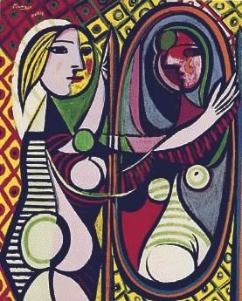
Artwork

Slide 4
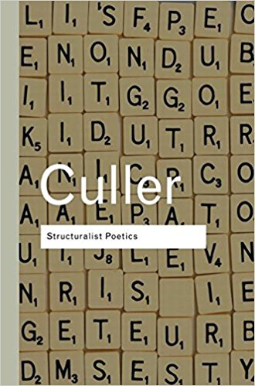
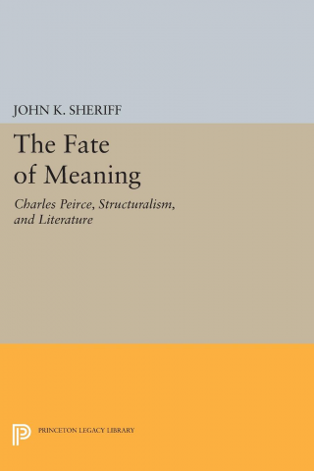
Literature

Slide 5
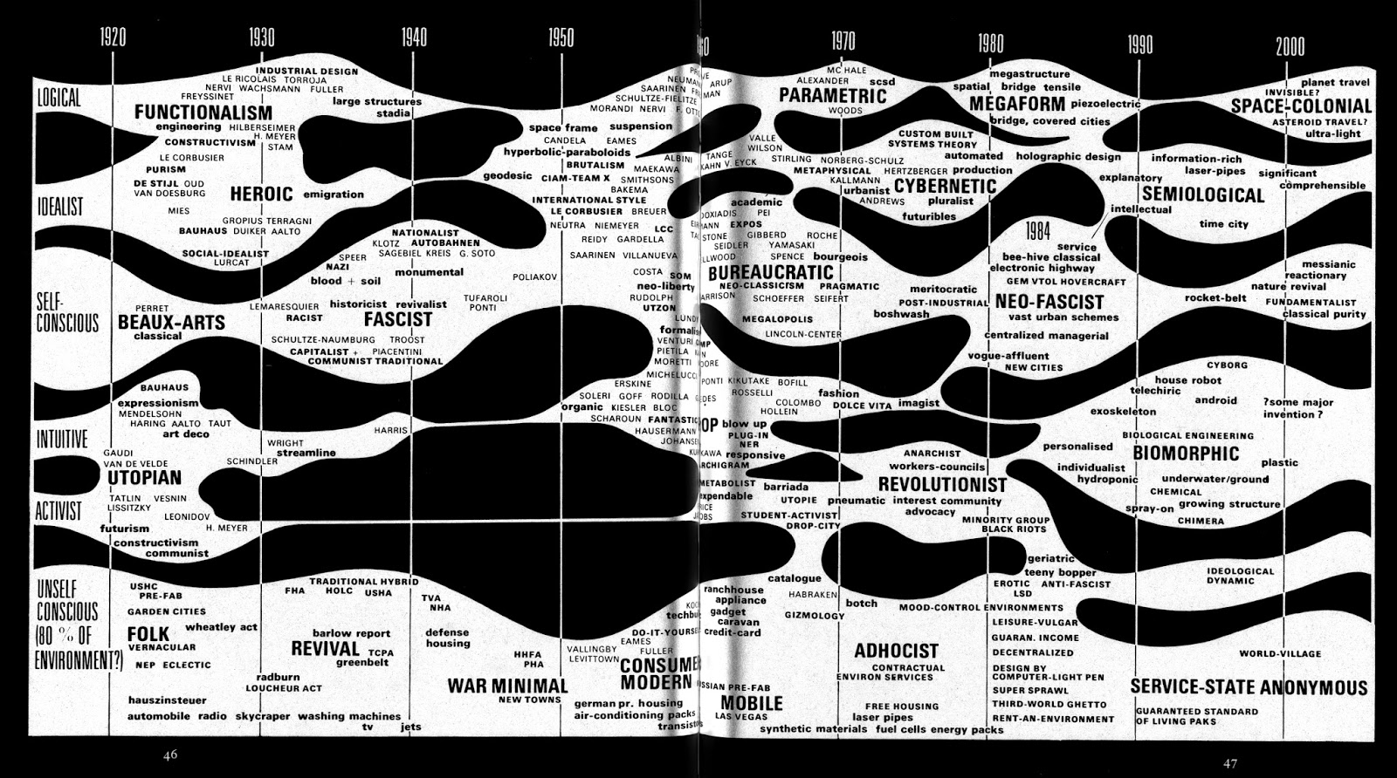
Notes:
And as Charles Jencks state in his famous book The Architecture of the Jumping Universe
which was published at 1995 when he put a pilot view of trends in architecture
And figure out that the sixteenth of the last century is the period of structural trend in architecture

Slide 7
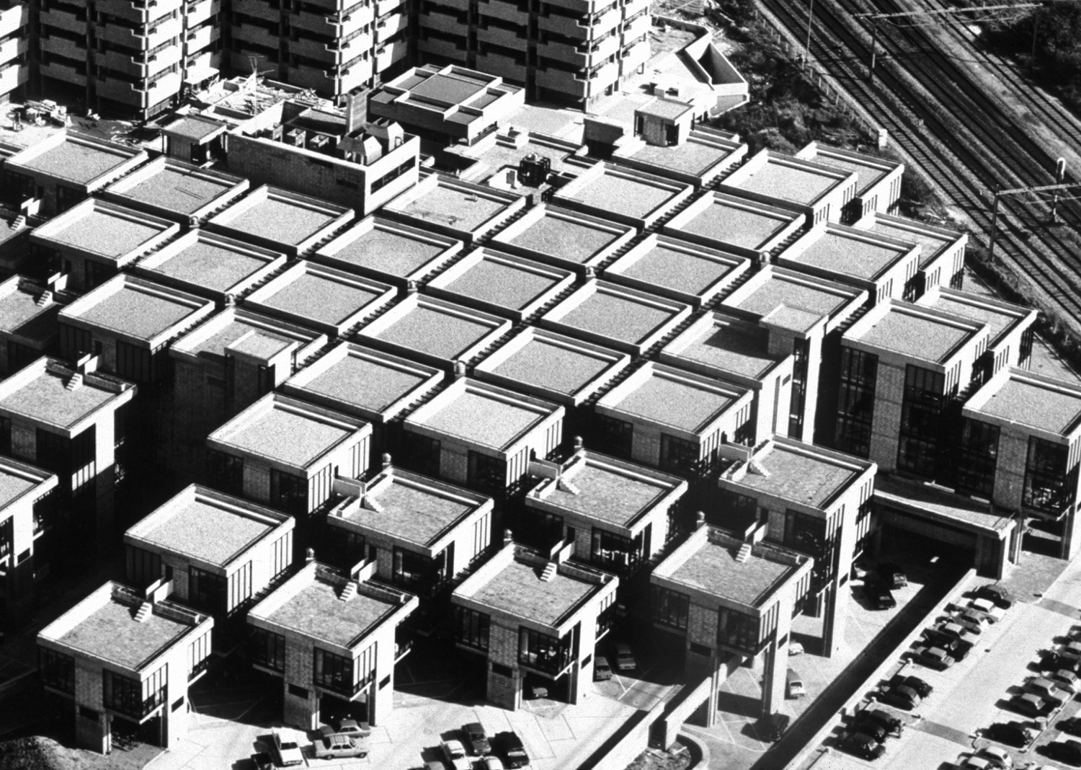
Notes:
And the world start to see architecture through its segments

Slide 8
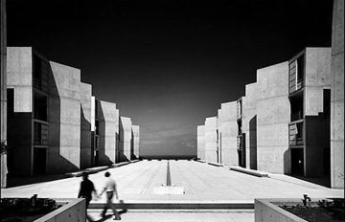
Notes:
And read the form from its countable perspective

Slide 9
Linguistics
Ferdinand de Saussure
Charles Sanders Peirce
Roman Jakobson
Claude Lévi-Strauss
Noam Chomsky
Notes:
فرديناند دي سوسيير
شارل ساندرس بيرس
رومان جاكوبسون
ليفي شتراوس
نعوم جومسكي

Slide 10
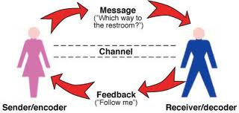
Communication Theory
Notes:
The founders and developers of communication theory and linguistics in its semiotics/semiology

Slide 11
Architectural representation and meaning.
FORM
Function
FUNCTION
Give Meaning
_{Form}
Express
Function
Notes:
The relation between form and function is seen as the relation between meaning and expression

Slide 12
Semiotics
Semiotics is the science of studying systems of signs within a culture
Any architectural form can be a seen as a symbol, reference, referent
Notes:
Again according to the model of Charles Jencks Any architectural form can be a seen as a symbol which is form word or globally as signifier
referent which is percept, denotatum thing
and reference, which is content, concept signified

Slide 13
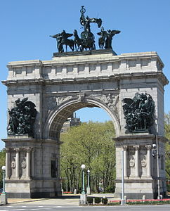
Architectural representation and meaning
Meanings in architectural forms depends upon the process of interpretation, which is shaped by the society.
ELITE
ORDINARY PEOPLE
Notes:
According to that model Meanings in architectural forms depends upon the process of interpretation, which is shaped by the society.
and always the elite takes small space into this interpretation

Slide 14
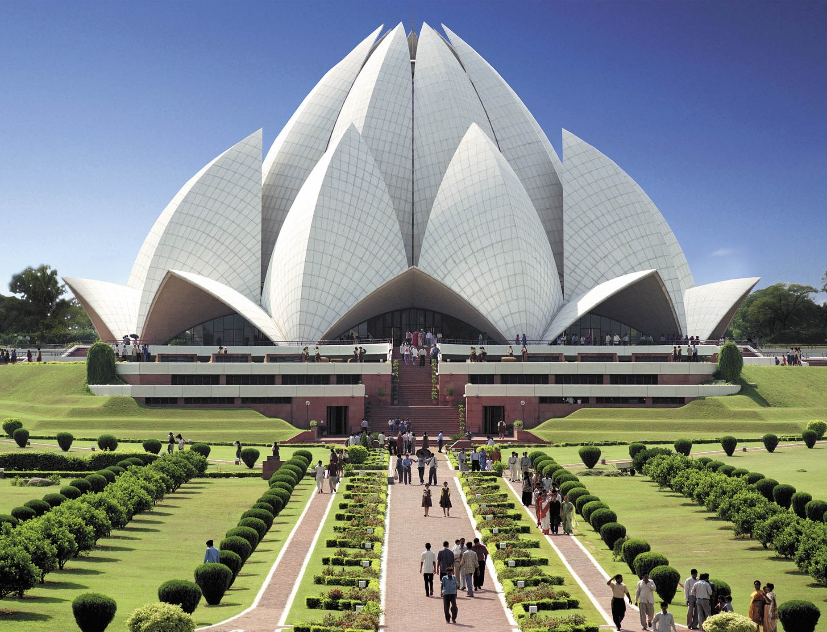
Notes:
Into this way we can see lotus temple in New Delhi as a referent of the lotus flower which forms a sign of purity into the religion of Bahá'í

Slide 15
Notes:
In the same way of seeing opera Sydnee as an symbol of sailing boats agglomeration at the port

Slide 16
Form Production
Thoughts
Symbols
Form

Slide 17
Notes:
Now according to the Parthes paradigm
Like most of Darren Aronofsky works which open the door to the audience to understand the concepts according to their interpretation

Slide 18
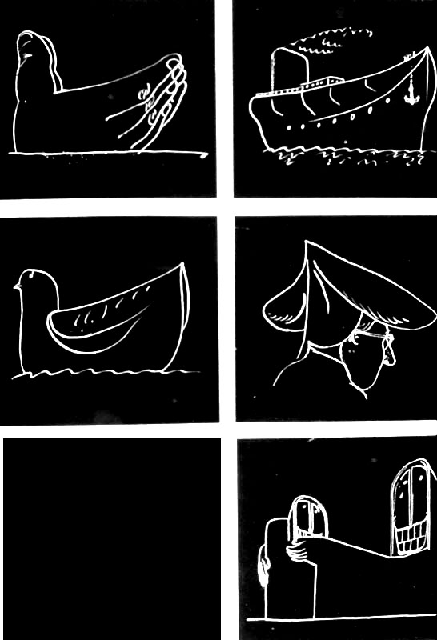
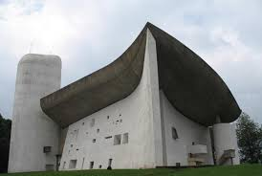
Changing paradigm
Notes:
Always ronchamp chapel seen as several interpreted symbols

Slide 19
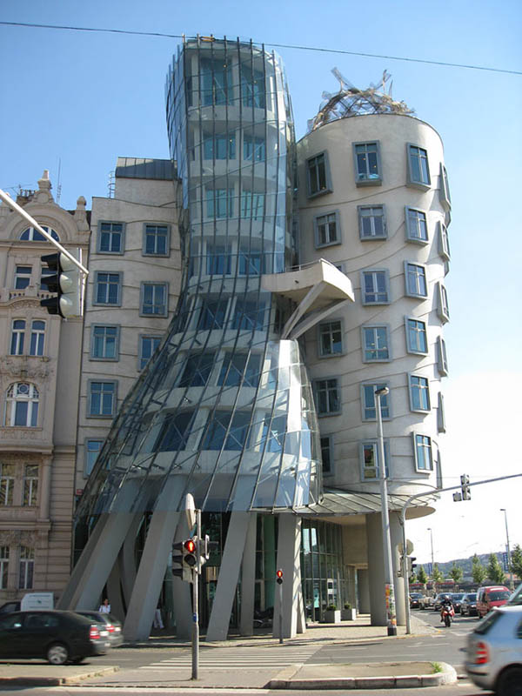
Radicalism
Happened when the meaning intention of architect is eliminated to the benefit of interpreted symbols
ORDINARY
ELITE
Notes:
We lost the ordinary people intentions and emotions

Slide 20
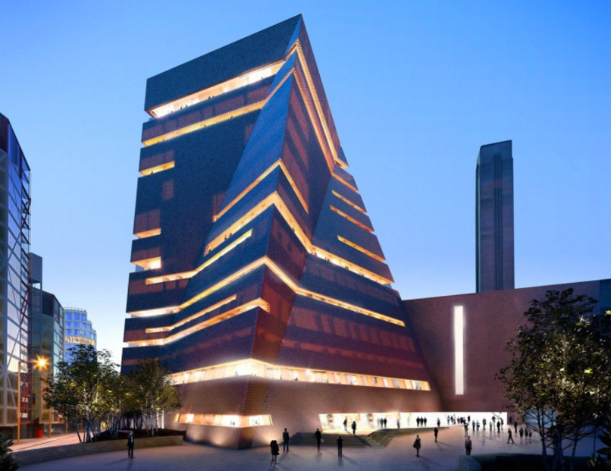

Slide 21
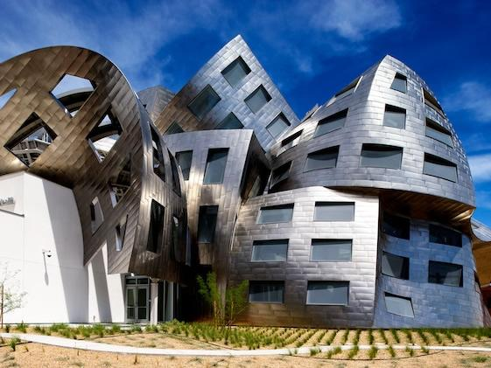

Slide 22
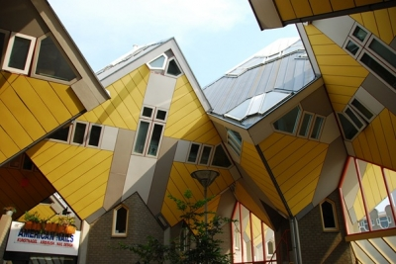

Slide 23
Pillars of Vitruvius
Firmness
Utility
Esthetics

Slide 24
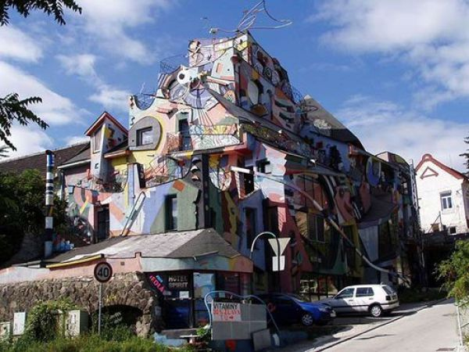

Slide 27
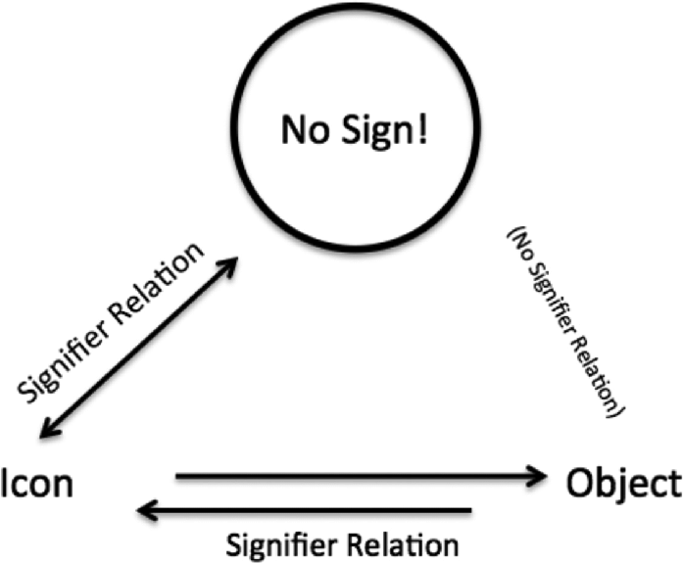
Significant and Signifier

Slide 28
Structuralism
Post Structuralism
Deconstruction

Slide 29
The death of the Architect
the birth of the Audience cause

Slide 30
THANK YOU

