Slide 1
How forex and stock market works
Cihan University- Sulaimani
Faculty of Administration and Financial sciences
Department of Banking and Financial Science
Assistant Lecturer: Hazhar Khalid Ali

Slide 2
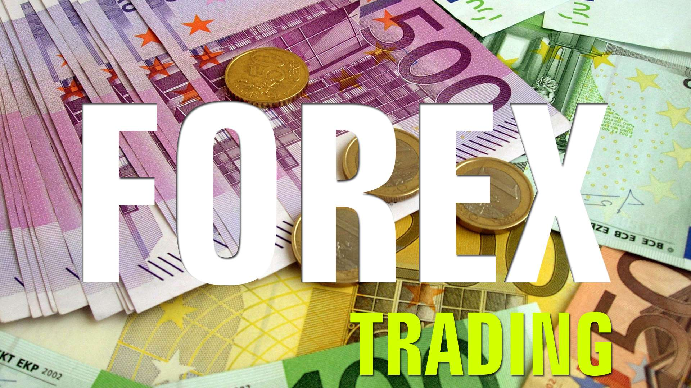
The FOREX Markets Acronym
FOR EX
THE FOREIGN EXCHANGE MARKET
At the FOREX market we Trade all major Foreign Currencies such as US Dollar, GBP, EUR, JPY. etc.,

Slide 3
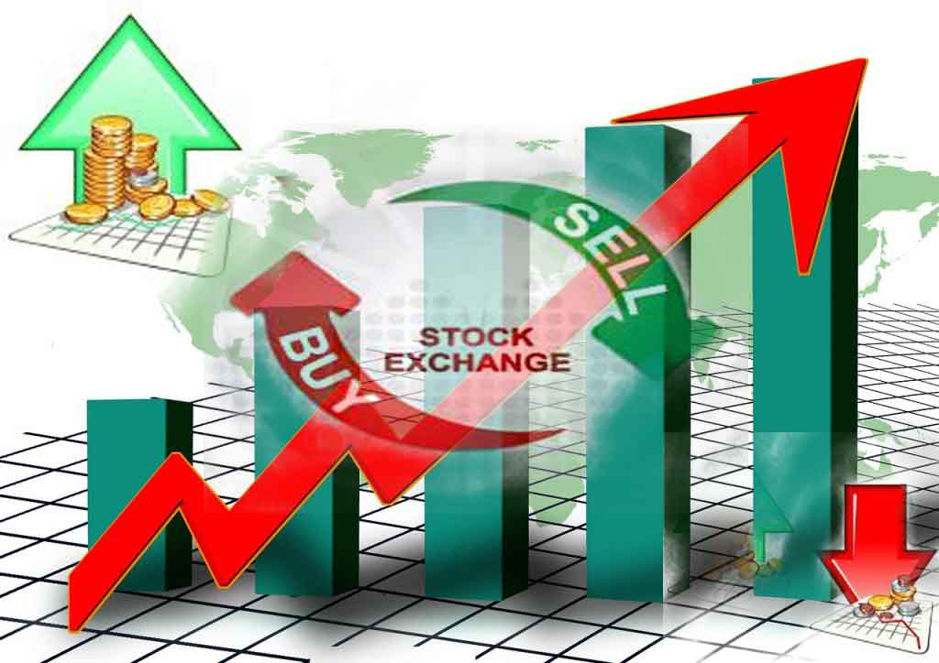
The Stock Market
At the stock market we Trade the companies share such as google, yahoo, amazon, apple, Toyota. Etc.…

Slide 4
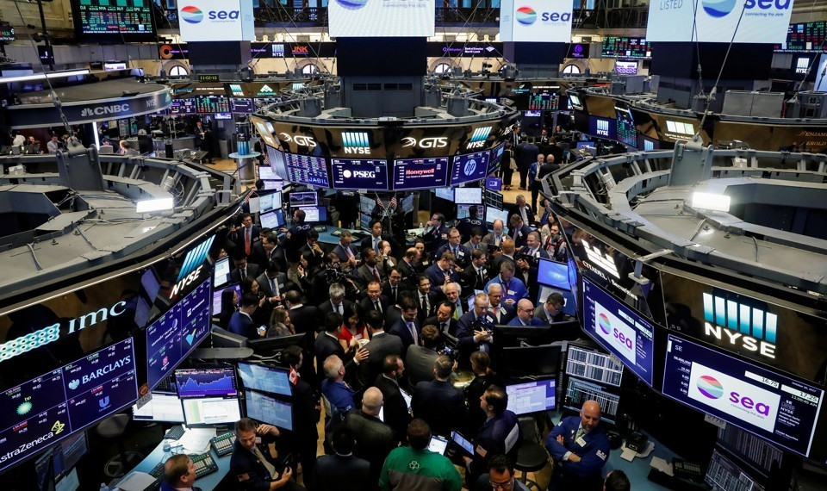
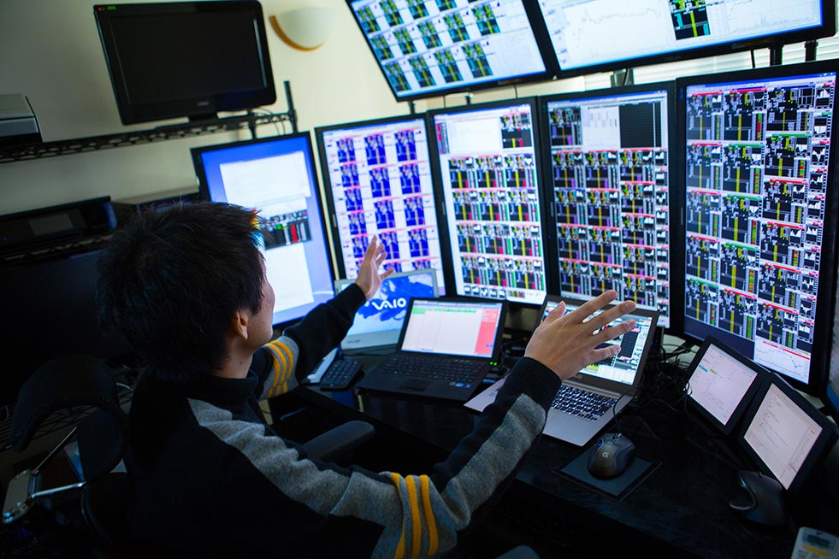
How to access to the FOREX and STOCK markets
Centralized exchanges
secondary markets where buyers and sellers meet in a central, physical location
Over-the-counter markets (OTCs)
Decentralized secondary market where dealers stand ready to buy and sell securities electronically.

Slide 5
Forex is the Biggest market in the world
The amount of trades in both FOREX and Stock Market per day:

Slide 6
The Mechanism of the Market
Big Institutional Players
There are 7-10 total large banks/institutions estimated to be trading Forex such as Deutschbank, UBS, Barclays, etc,
Trade between each other and with Prime Brokers and Spread is 1 pip
Prime Brokers
Prime Brokers
There are 25-50 total estimated Prime Brokers trading Forex.
Prime Brokers are large capital firms that offers financial services to the trading industry. Spread is 1.2 pips
Brokers
Brokers
Brokers
There are 100+ total estimated Brokers trading Forex
These firms send trades by individual customers to larger institutions. Spread is 2-3 pips
Traders
Traders
Traders
Traders

Slide 7
Broker services to traders
create an account
Meta trader (software program for trading)
Arranges transactions between a buyer and a seller for a commission
Money transferring ( Bank transfer, VISA, MASTER, Web Money, PayPal, Skrill,NETELLER. Etc.
Leverage of 1:1
1:100
1:200
1:500

Slide 8
Meta trader (software program for trading) In PC or Mobile Phone.

Slide 9
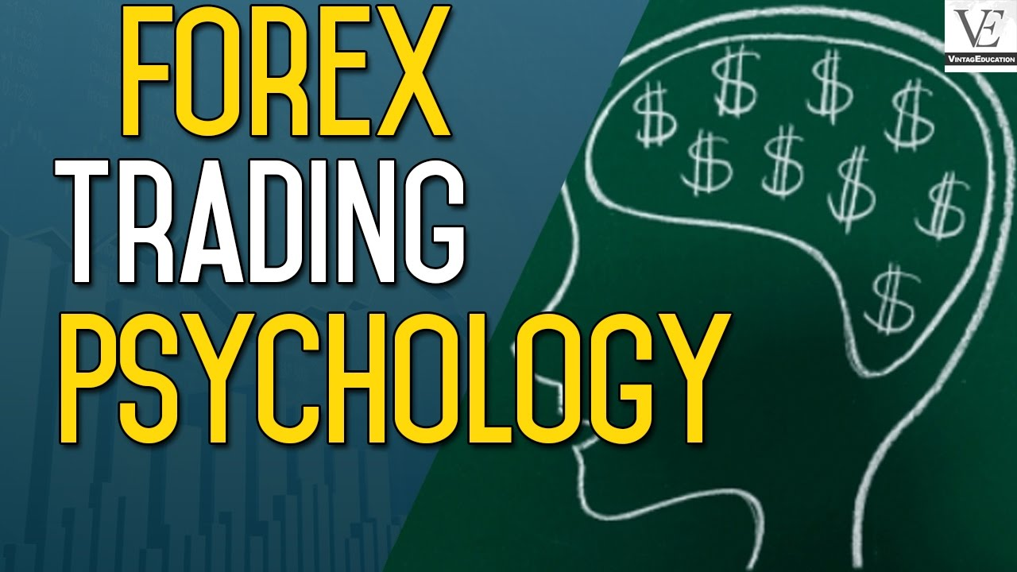
There are some unfortunate facts about this Market !!!!
There are a lot of active FAKE Broker.
Most of them are located to those countries with less government regulation
Due to complexity of the market the average of traders who loss is about 70% and there are a lot of reasons for that such as;
Less knowledge about risks related to this market
Less knowledge about Money Management
Less knowledge about both of technical and fundamental analysis
Psychological facts (Traders accept few profits rather than quitting, which lead them to bankruptcy). This case even will happen to Forex professional traders. This case proved by some recent articles

Slide 10
FOREX in Kurdistan
There is not any Broker in Kurdistan, there are some companies which they act as a Broker but in reality they just serve foreign Broker for a commission.
The percentage of the traders who loss in Kurdistan is around 80%.
The percentage of the traders who gain is around 15% who are those investors with a small amount of equity
The amount of losses in Kurdistan approximately are Millions US-Dollar per a month, and all those money go out of the country.

Slide 11
THANK YOU

