Slide 1
FAST FINANCIAL MODELLING
Cihan University- Sulaimani
Faculty of Administration and Financial sciences
Department of Banking and Financial Science
Assistant Lecturer: Hazhar Khalid Ali

Slide 2
Standardize
In 2011 Apple sold 65 million phone
Why
apple has more cash than U.S government ?
Apple
500,000
Apps
$
Common Programing
Language
USA

Slide 3
Alfred north whitehead
Mathematician & Philosopher
“Civilization advances by extending the number of important operation we can do without thinking about them”

Slide 4
FAST Financial Modelling
FAST modelling is the new and standard way to deal with models, it controls the structure and outline of viable spreadsheets, using a standardized structure and simple, short formulae that can be understood by modellers and non-modellers alike.
That is all about FAST Financial modelling, is the common language of Financial modelling

Slide 5
The FAST Acronym
F
Flexible
To be effective, the structure and style of models require flexibility for both immediate usage and the long term.
A
Appropriate
Models must reflect key business assumptions directly and faithfully without being cluttered in unnecessary detail.
S
Structured
Rigorous consistency in layout and organisation is essential in retaining the model’s logical integrity over time, particularly as a model’s author may change.
T
Transparent
Effective models are founded upon simple, clear formulas that can be understood by other modellers and non-modellers alike.

Slide 6
FAST Standard organises and its rules
Microsoft Excel
is the tool used to create the model analogous
workbook
Workbook rules are concerned with how the subject should be divided up.
Worksheet
is similar to a chapter in a book. Worksheet rules are concerned with design layout, including column usage and breaking the chapter’s subject into ‘sections’ and‘paragraphs
The line item
Line items should have clear labels, clear unit designation, and their formulas should be short, simple, direct, and readily understood.

Slide 7
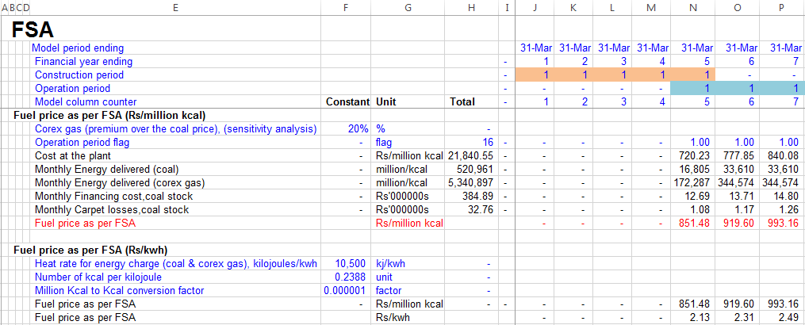
Structure of the Worksheet
There are two key rules in the design of a worksheet: each column should have a specific purpose and each purpose should have a specific column.
columns A-D are for section and sub-section labels.
column E is the rule label.
column F is the constant, which will usually be inputs.
column G is unit labels.
column H is the row total.
columns J onwards are time-base columns.

Slide 8
Calculation Blocks
Building up models using a calculation block is a key means of ensuring model readability. The following rules govern construction of the calculation block:
1. All calculations are contained in the block
2. One calculation per block
3. Calculation is the last item in the block
For instance, Table slide 7 presents two calculation blocks for fuel-supply agreements.
Other benefits of the calculation block are:
1. All inputs are listed next to the calculation itself
2. Ease-of-navigation using links
3. ‘Smart’ in finding and resolving errors

Slide 9
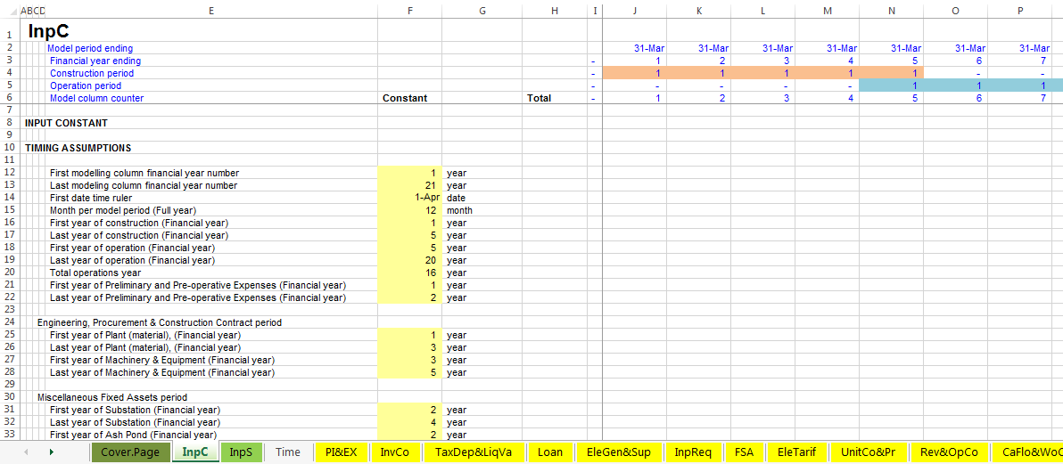
Sheets
Input sheet
Timing sheet
Calculation Sheets

Slide 10
Formula Design Fundamentals
Formulas must be:
Consistent
Short
Simplicity
Clarity
Do not write a formula longer than your thumb
No formula should take more than 24 seconds to explain
Do not write multi-line formulas

Slide 11
Timing Flags
Used to denote the occurrence of a particular event, that is, to place a certain
value in time. Flags contain values of either (0) or (1)
Flag of (0) means nothing happen
Flag of (1) means something is happen
Use timing flags
Only create a flag when it is required
Only use flags that are relevant to the logic they are being applied to

